Slide 1
Dealing with composite keys
Dealing with composite keys

Slide 2
Dealing with composite keys
Note: This Lab uses lab3.xlsx in Sales Model

Slide 3
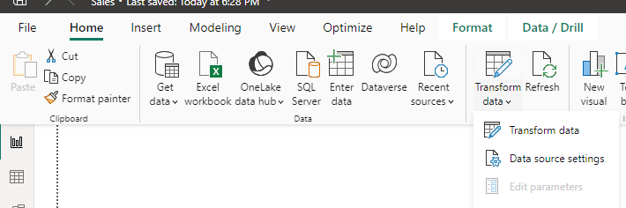
Dealing with composite keys
Start by importing data into Power BI
Click Transform Data to open Power Query Editor

Slide 4
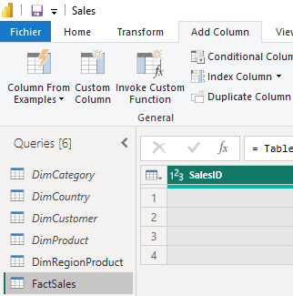
Dealing with composite keys
Start by importing data into Power BI
Select FactSales in query zone then Add Column then Custom Column
2
3
1

Slide 5
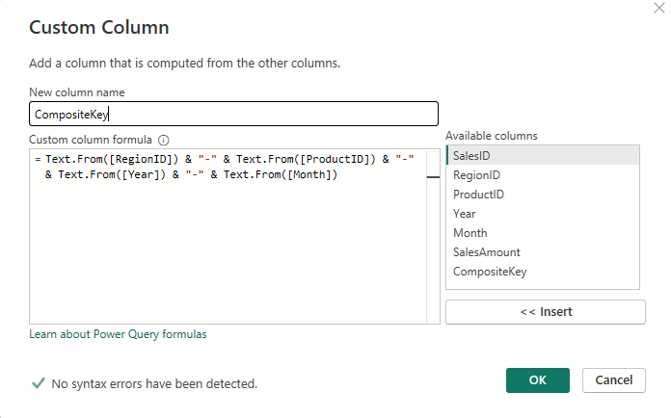
Dealing with composite keys
Add this formula to generate CompositeKey
Text.From([RegionID]) & "-" & Text.From([ProductID]) & "-" & Text.From([Year]) & "-" & Text.From([Month])

Slide 6
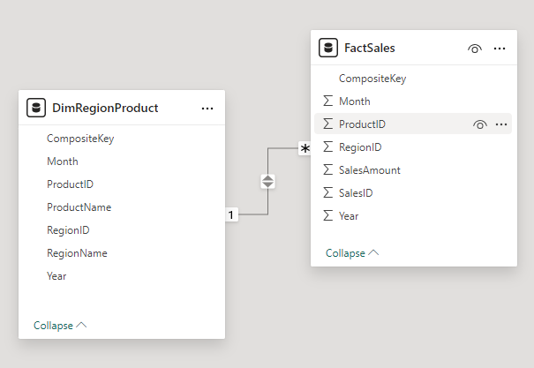
Dealing with composite keys
Repeat the steps above with the same formula to create a CompositeKey column for the DimRegionProduct too
Go to Model View and create a one-to-many relationship,
From DimRegionProduct[CompositeKey] → FactSales[CompositeKey]

Slide 7
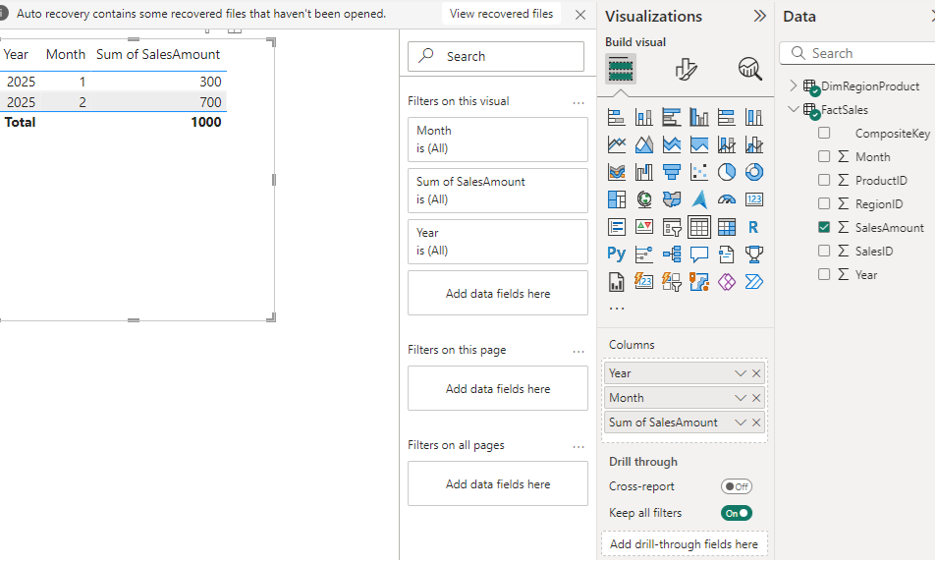
Dealing with composite keys
Create Table visual to test the model, add Year and Month from the dimension and Sales Amount from FactSales

Slide 8
Thank you
Thank you

